Slide 1
Industrial Applications
Product Training
Product Line Industrial Filtration Technology
Status: March 2012

Slide 2
Content
Central Applications
Air Quality – air for general purpose
Air for high quality purpose
Air for Critical Applications
Filter performance overview

Slide 3
Content
Central Applications
Air Quality – air for general purpose
Air for high quality purpose
Air for Critical Applications
Filter performance overview

Slide 4
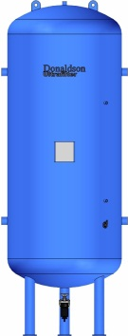
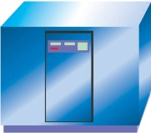

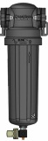

Industrial Applications
Central Application
De-Central Application
(POU = Point of Use)
Laser Technology
Compressor Room
Breathing Air
Paint Shop
Process Air
…??? Application
Basic purification
POU or special purification

Slide 5




Industrial Applications
Central Application
Basic purification requirements depending on application conditions:
Compressed Air Generation
Oil- lubricated
Oil-free
Compressed Air Capacity
Volume flow
Ambient Conditions
Temperature >+3ºC
Temperature ≤+3ºC
Operating Conditions
Pressure
Temperature
Customer specific requirements

Slide 6
Industrial Applications
Selection criteria for air purification products
Air Flow
Filters/Separators: DF, AG, SG?
Dryers: Buran, Boreas, Brisa?
Air Temperature
After-cooler UFK-W / UFK-L needed?
Air Receiver Vessel?
Pollutions
Oil aerosol + oil vapor?
Liquid water or aerosols + water vapor?
Solid particles?
Air Quality
General purpose?
High quality?
Critical or special applications?
Other pollutions (CO₂, C_{n}H_{n}, etc.)
Dryers: UP 2000, Classic, Dryer Systems?

Slide 7
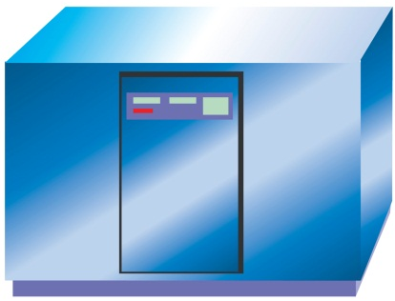
Industrial Applications
What about „oil-free“ generated air?
NO_{X}
VOC
SO₂
CO
Compressor
NH₃
CO₂
O₃
Compressed Air
Atmospheric Air
VOC
SO₂
NO_{X}
CO₂
O₃
NH₃
NO_{X}
CO₂
VOC
VOC
CO
NH₃
Particles
H₂O
Even „oli-free“ generated air needs purification
Water separators + filters (downstream coolers)
Dryers (removal of water vapor)
Activated carbon adsorbers / filters (removal of contaminants of ambient air)

Slide 8
Content
Central Applications
Air Quality – air for general purpose
Air for high quality purpose
Air for Critical Applications
Filter performance overview

Slide 9
Industrial Applications
Air Quality
Recommended Quality Classes acc. to VDMA 15390:2012 (Draft)
(German Engineering Federation)
Air for general purpose
Application | Solid particles | Water (vapor) T_{amb} >3ºC | Water (vapor) T_{amb} ≤3ºC | Total oil
Control air for oil/gas drilling | 7 | 4 | 2-3 | 4
Mining tools (pneumatic drill) | 7 | 4 | 2-3 | 4
Pneumatic drive (actuators) | 2 | 4 | 2-3 | 2
Air blast (mould tools, air guns) | 2-3 | 4 | 2-3 | 2
Pre-purified air to point of use applications | 2-3 | 4 | 2-3 | 2-3
Control air for industrial applications | 2-3 | 4 | 2-3 | 2
Transport air for industrial applications | 3 | 4 | 2-3 | 2

Slide 10
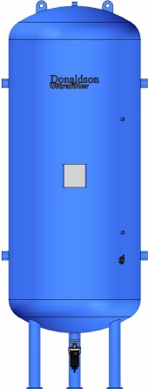

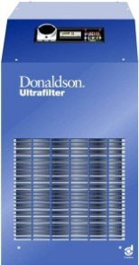


Industrial Applications
Central application with oil-lubricated compressor
Volume flow < 1100 m³/h
Ambient temperature (T_{amb}) 15ºC…25ºC
Compressor with integrated air-cooled cooler (T_{out} ≈ T_{amb}+10K)
Air receiver vessel downstream compressor (optional)
Air for general purpose (Solution 1)
DF-C
DF-V
DF-M
Pre filter required upstream fridge dryer – protection of heat-exchanger

Slide 11
Industrial Applications
Air for general purpose (Solution 1)
DF-C
DF-V
DF-M
Solid Particles
7
6
4
4
2
Water Vapor
7
7
7
4
4
Total Oil
5
4
3
3
2

Slide 12
Industrial Applications
Central application with oil-lubricated compressor
Volume flow < 1100 m³/h
Ambient temperature (T_{amb}) 15ºC…25ºC
Compressor with integrated air-cooled cooler (T_{out} ≈ T_{amb}+10K)
Air receiver vessel downstream compressor (optional)
Air for general purpose (Solution 2)
DF-P
DF-M
Pre filter P required to remove big particles and water/oil aerosols

Slide 13
Industrial Applications
Air for general purpose (Solution 2)
DF-P
DF-M
Oil aerosols could be present after fridge dryer!
Solid Particles
7
7
2
2
2
Water Vapor
7
7
7
4
4
Total Oil
5
4
2
2
2

Slide 14
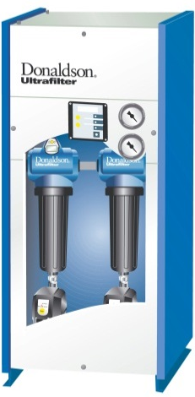
Industrial Applications
Central application with oil-lubricated compressor
Volume flow < 1100 m³/h
Ambient temperature (T_{amb}) -10ºC…25ºC
Compressor with integrated air-cooled cooler (T_{out} ≈ T_{amb}+10K)
Air receiver vessel downstream compressor (optional)
Air for general purpose (Solution 3)
DF-C
DF-V
Optional
HED/ALD
DF-M
Adsorption dryer required for pressure dewpoint < -10ºC
Dustfilter DF-M required to achieve particle Class 2

Slide 15
Industrial Applications
Air for general purpose (Solution 3)
DF-C
DF-V
Optional
HED/ALD
DF-M
Solid Particles
7
6
4
4
5
2
Water Vapor
7
7
7
4
2-3
2-3
Total Oil
5
4
3
3
2
2

Slide 16
Content
Central Applications
Air Quality – air for general purpose
Air for high quality purpose
Air for Critical Applications
Filter performance overview

Slide 17
Industrial Applications
Air Quality
Recommended Quality Classes acc. to VDMA 15390:2012 (Draft)
Air for high quality purpose
Application | Solid particles | Water (vapor) T_{amb} >3ºC | Water (vapor) T_{amb} ≤3ºC | Total oil
Pre-purification for process air (Pharmaceutical, food + beverage industries) | 2 | 3-4 | 1-3 | 1
Blow moulding of plastics | 1 | 4 | 2-3 | 1
Instrument or blowing air for semiconductor industry | 1 | 1-2 | 1-2 | 1
Measurement and test technology | 1 | 4 | 1-3 | 1
Transport air for process applications | 1-2 | 4 | 2-3 | 1-2

Slide 18
Industrial Applications
Central application with oil-lubricated compressor
Volume flow < 1100 m³/h
Ambient temperature (T_{amb}) -10ºC…25ºC
Compressor with integrated air-cooled cooler (T_{out} ≈ T_{amb}+10K)
Air receiver vessel downstream compressor (optional)
Air for high quality purpose (Solution 1)
DF-C
DF-V
Optional
MSD
DF-A
Pre filter required upstream fridge dryer – protection of heat-exchanger
Cyclone separator required to remove liquid water during cold period

Slide 19
Industrial Applications
Air for high quality purpose (Solution 1)
DF-C
DF-V
Optional
MSD
DF-A
Solid Particles
7
6
4
4
5
1
Water Vapor
7
7
7
4
1-2
1-2
Total Oil
5
4
3
3
2
1

Slide 20
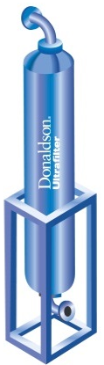
Industrial Applications
Central application with oil-lubricated compressor
Volume flow < 1100 m³/h
Ambient temperature (T_{amb}) -10ºC…25ºC
Compressor with integrated air-cooled cooler (T_{out} ≈ T_{amb}+10K)
Air receiver vessel downstream compressor (optional)
Air for high quality purpose (Solution 2)
DF-C
DF-V
Optional
MSD
AKC
DF-Combi
V + S
AKC provides extended activated carbon lifetime
Additional dust filter(s) required downstream AKC

Slide 21
Industrial Applications
Air for high quality purpose (Solution 2)
DF-C
DF-V
Optional
MSD
AKC
DF-Combi
V + S
Solid Particles
7
6
4
4
5
5-7
1
Water Vapor
7
7
7
4
1-2
1-2
1-2
Total Oil
5
4
3
3
2
1
1

Slide 22
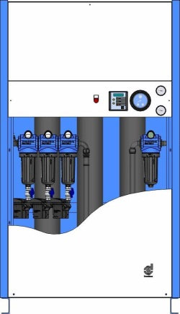
Industrial Applications
Central application with oil-lubricated compressor
Volume flow < 1100 m³/h
Ambient temperature (T_{amb}) -10ºC…25ºC
Compressor with integrated air-cooled cooler (T_{out} ≈ T_{amb}+10K)
Air receiver vessel downstream compressor (optional)
Air for high quality purpose (Solution 3)
DF-C
(Optional)
DF-V
(Optional)
Optional
OFP
DF-S
OFP provides extended activated carbon lifetime
Additional dust filter(s) required downstream OFP if particle Class 1 is required

Slide 23
Industrial Applications
Air for high quality purpose (Solution 3)
DF-C
(Optional)
DF-V
(Optional)
Optional
OFP
DF-S
Solid Particles
7
6
4
4
3
1
Water Vapor
7
7
7
4
1-2
1-2
Total Oil
5
4
3
3
1
1

Slide 24
Content
Central Applications
Air Quality – air for general purpose
Air for high quality purpose
Air for Critical Applications
Filter performance overview

Slide 25
Industrial Applications
Air Quality
Recommended Quality Classes acc. to VDMA 15390:2012 (Draft)
Air for Critical Applications
Application | Solid particles | Water (vapor) T_{amb} >3ºC | Water (vapor) T_{amb} ≤3ºC | Total oil
Breathing Air (DIN EN12021 + DIN EN ISO 7396-1) | 2 | 3-4 | 2 | 1
Laser applications | 1-2 | 1-3 | 1-3 | 1
Painting + surface refinement (Silicone-free) | 1-2 | 4 | 2-3 | 1
Process air for point of use applications | 1-2 | 1-2 | 1-2 | 1
Extreme conditions (Heavy duty, outdoor) | 1-3 | 1-3 | 1-3 | 1-2

Slide 26

Industrial Applications
Breathing air applications
Contaminant | Required Quality EN12021 (Respiratory protective devices) | Required Quality ISO7396-1 (Medical air)
Particles | Not specified (as low as possible) | Class 2 (ISO8573-1:2001)
Water | PDP ≥ 5ºC below min. ambient temperatue | 67 ppm or 870 ppm
Oil (liquid + vapor) | ≤ 0,5 mg/m³ (EN12021) | ≤ 0,1 mg/m³
CO | ≤ 15 ppm | ≤ 5 ppm
CO₂ | ≤ 500 ppm | ≤ 500 ppm
SO₂ | Not specified | ≤ 1 ppm
NO_{X} | Not specified | ≤ 2 ppm
These contaminants can only be removed by breathing air systems Ultrapure ALG-S or Ultrapure/Medipac2000

Slide 27
Industrial Applications
Breathing air applications
Solution 1:
DF-V
DF-T
Central Purification
and…
CO ≤ 5 ppm
CO₂ ≤ 500 ppm
SO₂ ≤ 1 ppm
NO_{X} ≤ 2 ppm
Pressure regulator
Humidifier
Solid Particles
2
2
1
Water Vapor
4
4
4
Total Oil
4-5
3
1

Slide 28
Industrial Applications
Breathing air applications
Solution 2:
DF-V
DF-S
DF-A
Central Purification
and…
CO ≤ 5 ppm
CO₂ ≤ 500 ppm
SO₂ ≤ 1 ppm
NO_{X} ≤ 2 ppm
Pressure regulator
Humidifier
Solid Particles
2
2
1
1
Water Vapor
4
4
4
4
Total Oil
4-5
3
2
1

Slide 29
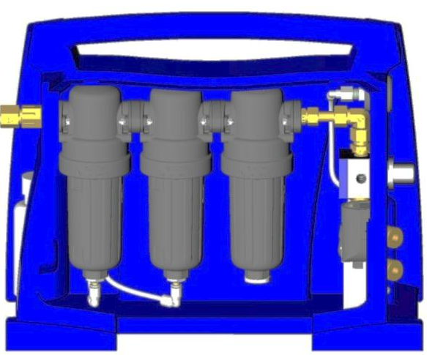
Industrial Applications
Breathing air applications
Solution 3: ALG20
DF-M
DF-S
DF-A
Central Purification
and…
CO ≤ 5 ppm
CO₂ ≤ 500 ppm
SO₂ ≤ 1 ppm
NO_{X} ≤ 2 ppm
Humidifier
Solid Particles
2
2
1
1
Water Vapor
4
4
4
4
Total Oil
4-5
2
2
1

Slide 30
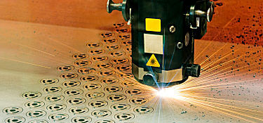
Industrial Applications
Laser applications
Cutting gas
Purging gas
Application | Solid particles | Water (vapor) T_{amb} >3ºC | Water (vapor) T_{amb} ≤3ºC | Total oil
Laser applications | 1-2 | 1-3 | 1-3 | 1
For some purge gas application further required:
CO₂ content as low as possible
< 100 ppm minimum requirement
< 50 ppm target

Slide 31
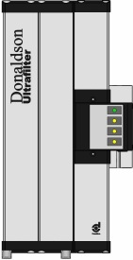
Industrial Applications
Laser applications
Solution 1:
UP2000
DF-A or
DF-T
Central Purification without adsorption dryer
UP2000 provide also CO₂ reduction
Size as big as possible for most efficient CO₂ reduction
Solid Particles
2
5
1
Water Vapor
4
1-2
1-2
Total Oil
2
2
1

Slide 32
Industrial Applications
Laser applications
Solution 2:
OFP2000
DF-S
Central Purification without adsorption dryer
OFP2000 provide also CO₂ reduction
Size as big as possible for most efficient CO₂ reduction
Solid Particles
2
3
1
Water Vapor
4
1-2
1-2
Total Oil
2
1
1

Slide 33
Industrial Applications
Laser applications
Solution 3:
DF-A or
DF-T
Central Purification with adsorption dryer
No CO₂ reduction!
If CO₂ reduction is required, install UP2000 upstream
Solid Particles
2
1
Water Vapor
1-2
1-2
Total Oil
2
1

Slide 34
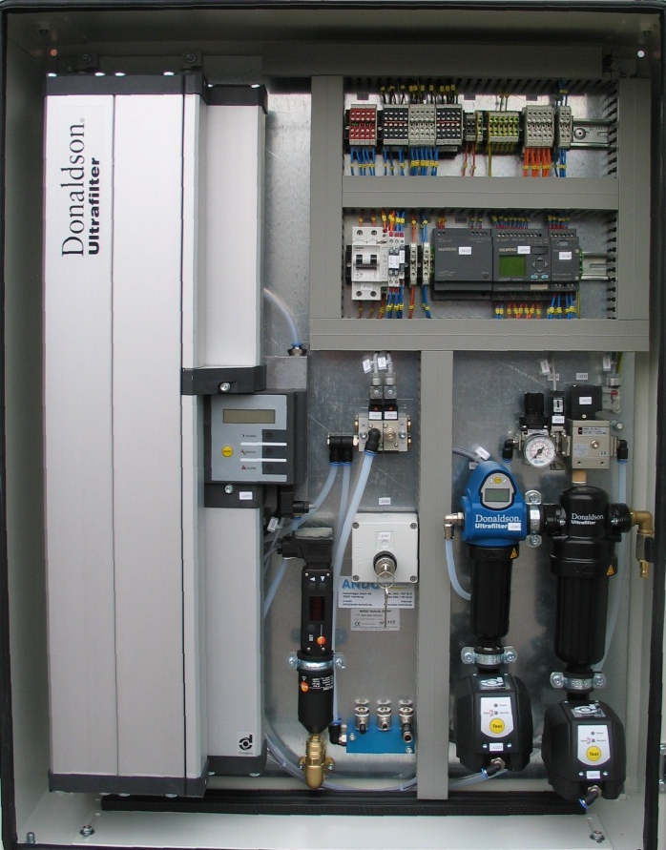
Industrial Applications
Laser applications
OEM solution
OFP2000
+
FFP
DF-C
DF-M
No central Purification
Solid Particles
7
6
2
2-3
Water Vapor
7
7
7
1-2
Total Oil
5
4
2
1

Slide 35
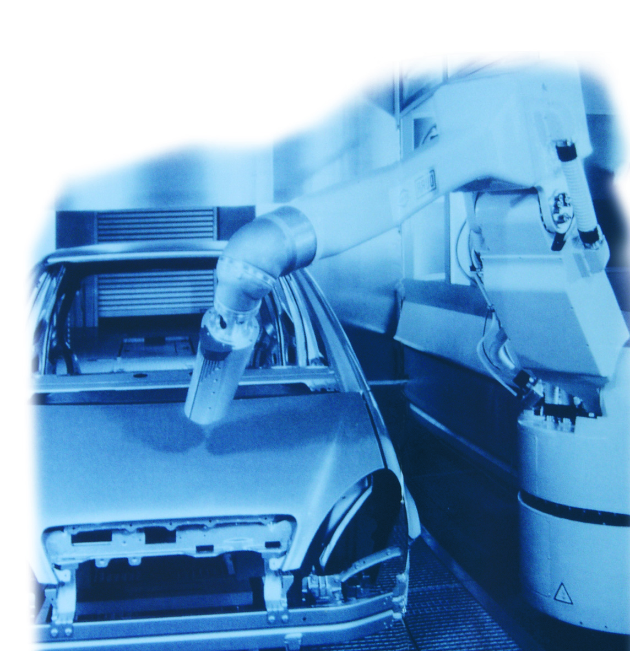
Industrial Applications
Painting applications
Application | Solid particles | Water (vapor) T_{amb} >3ºC | Water (vapor) T_{amb} ≤3ºC | Total oil
Painting + surface refinement (Silicone-free) | 1-2 | 4 | 2-3 | 1
For painting applications further required:
Free of silicone and parting agent (DE: „labs-frei“)
Filters and dryers must be ordered with special item numbers (specification 0024)
All components free of silicone and specially cleaned (free of oil + grease)
Workers must wear gloves during assembly of housings and filter elements
Special packing (welded plastic bag) for elements

Slide 36

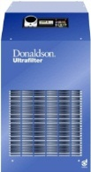



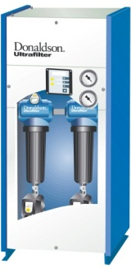


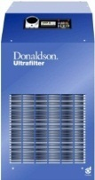



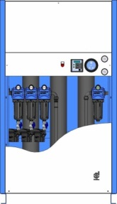




Industrial Applications
DF-C
DF-V
Optional
MSD
DF-A
Painting applications
Use air for high quality solutions…
DF-C
DF-V
Optional
MSD
AKC
DF-Combi
V + S
DF-C
(Optional)
DF-V
(Optional)
Optional
OFP
DF-S

Slide 37
Industrial Applications
Industrial air for process applications
Application | Solid particles | Water (vapor) T_{amb} >3ºC | Water (vapor) T_{amb} ≤3ºC | Total oil
Process air for point of use applications | 1-2 | 1-2 | 1-2 | 1
Clearly define interface between industrial air (not sterile) and process air (sterile).
Industrial Air
Process Air (sterile)

Slide 38
Industrial Applications
DF-C
DF-V
Optional
MSD
DF-A
Industrial air for process applications
Use air for high quality solutions…
DF-C
DF-V
Optional
MSD
AKC
DF-Combi
V + S
DF-C
(Optional)
DF-V
(Optional)
Optional
OFP
DF-S

Slide 39
Industrial Applications
Heavy duty / outddor applications
Application | Solid particles | Water (vapor) T_{amb} >3ºC | Water (vapor) T_{amb} ≤3ºC | Total oil
Extreme conditions (Heavy duty, outdoor) | 1-3 | 1-3 | 1-3 | 1-2
ATEX applications
Extremely low ambient temperature
Mobile applications
Please contact product line for special solutions!

Slide 40
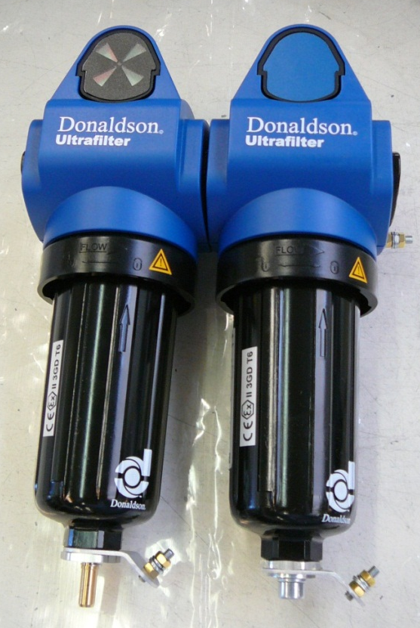
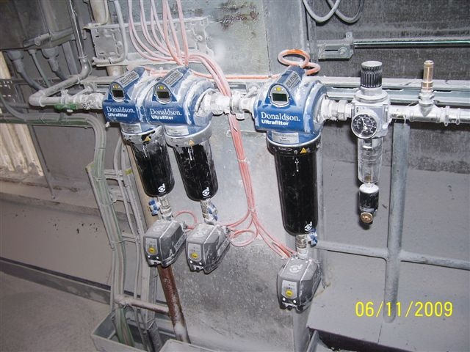
Industrial Applications
Heavy duty / outddor applications
DF filter in dust ambient – ATEX solution required
Filters and dryers must be ordered with special item numbers (specification 0031)

Slide 41
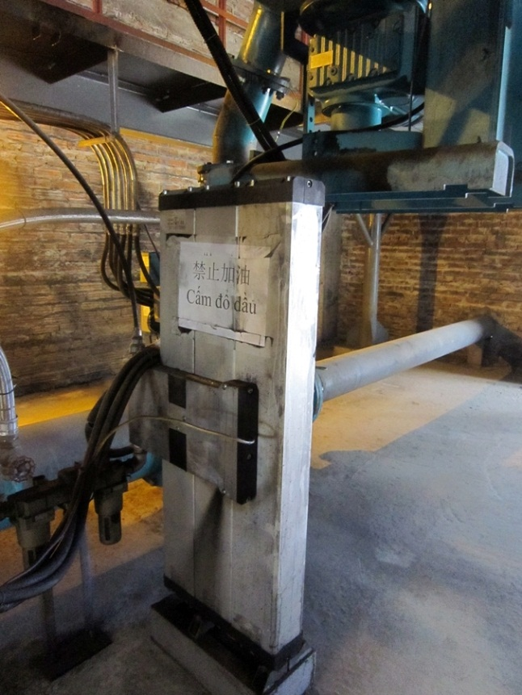
Industrial Applications
Heavy duty / outddor applications
Ultrapac 2000 in cement plant – ATEX solution required

Slide 42
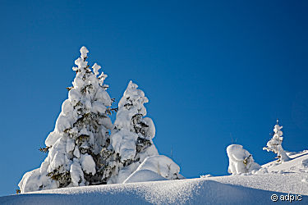
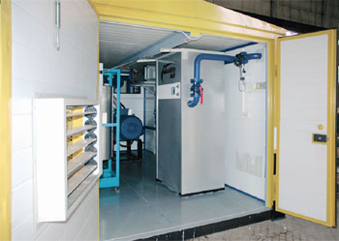
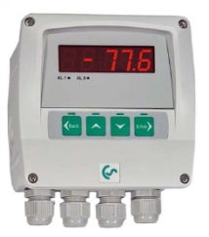


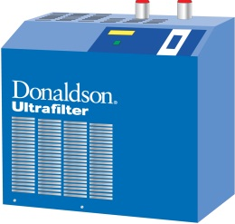
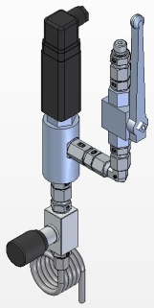
Industrial Applications
Heavy duty / outddor applications
T ambient < -50°C
Fridge dryer for summer period
Classic dryer for summer + winter period
PDP <-75ºC

Slide 43
Content
Central Applications
Air Quality – air for general purpose
Air for high quality purpose
Air for Critical Applications
Filter performance overview

Slide 44
Industrial Applications
Filter performance overview
Filter Grade | Oil Aerosol Efficiency (ISO12500-1) | Achievable Quality Class for particles | Achievable Quality Class for total oil
C | - | Class 6 | Class 4 - 5
P / PE | 90% | Class 7 (25µm) | Class 4
S / SB | - | Class 7 (25µm) | -
V | 96% | Class 4 - 5 | Class 3
FF | 99% | Class 3 | Class 2 - 3
M / MF | 99,7% | Class 2 (Pre filtration required) | Class 2
S / SMF | 99,8% | Class 1 (Pre filtration required) | Class 2
A / AK | - | Class 1 | Class 1 (Pre filtration required)
T | 99,8% | Class 1 | Class 1

Slide 45
Questions ?

